Slide 1
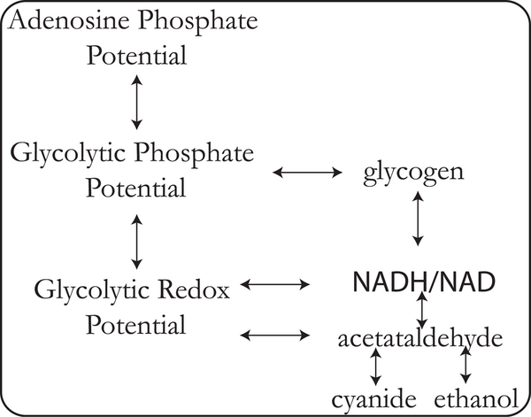
Figure 9. Simplified model of the yeast glycolytic pathway dictated by the fragmented pooling of the network.
Jamshidi N, Palsson BØ (2008) Top-Down Analysis of Temporal Hierarchy in Biochemical Reaction Networks. PLOS Computational Biology 4(9): e1000177. https://doi.org/10.1371/journal.pcbi.1000177
https://journals.plos.org/ploscompbiol/article?id=10.1371/journal.pcbi.1000177

