Slide 1
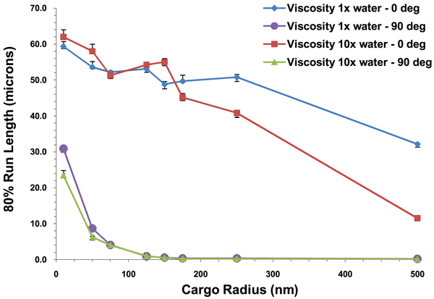
Figure 13. 20th percentile run length vs. cargo radius for 5 motors at the viscosity of water and 10 times the viscosity of water for cluster angles of 0 and 90°.
Erickson RP, Jia Z, Gross SP, Yu CC (2011) How Molecular Motors Are Arranged on a Cargo Is Important for Vesicular Transport. PLOS Computational Biology 7(5): e1002032. https://doi.org/10.1371/journal.pcbi.1002032
https://journals.plos.org/ploscompbiol/article?id=10.1371/journal.pcbi.1002032

